Slide 1
Metabolic Bone Diseases: A Clinical Pharmacy Perspective
Ahmed M. Sayed
Assistant lecturer
Department of Orthopedics and Trauma Surgery

Slide 2
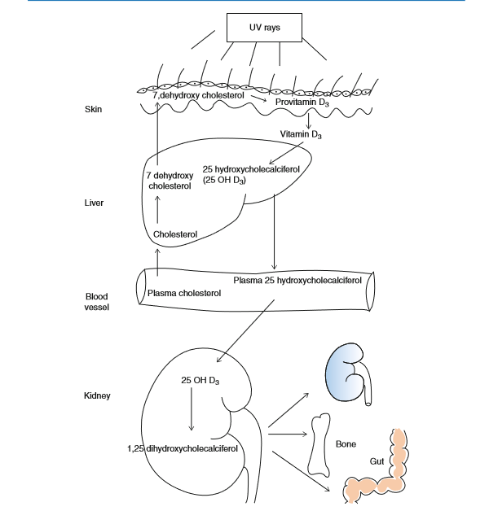
Vitamin D Metabolism
Sources:
  Dietary: Egg yolk, fish, milk.
  Endogenous: Synthesized in skin (cholecalciferol, D3).
  Exogenous: Ergocalciferol (D2) from plants.
Activation:
  Liver: 25-hydroxylation → 25(OH)D (calcidiol).
  Kidney: 1-hydroxylation → 1,25(OH)2D (calcitriol).→ ACTIVE FORM
Functions:
  Enhances intestinal calcium absorption.
  Enhances renal calcium reabsorption.
  Promotes mineralization of bone indirectly
  Regulates serum calcium and phosphorus levels.

Slide 3
Vitamin D Deficiency
Risk Groups:
  Breastfed infants, older adults, limited sun exposure, dark skin, obesity, malabsorption.
Serum Levels:
  Deficient: <30 nmol/L.
  Inadequate: 30-50 nmol/L.
  Sufficient: >50 nmol/L.
Daily Requirements:
  Children: 400 IU.
  Adults: 600 IU.
  Therapeutic: 1500-5000 IU.

Slide 4
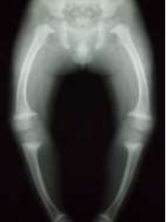
Rickets
Definition: Defective mineralization of osteoid due to inadequate calcium and/or phosphate and/or Vit D metabolism (before physeal closure).
Types:
Vitamin D Deficient: Nutritional, malabsorption. → MC
Vitamin D Resistant: Familial hypophosphatemia.
Vitamin D Dependent: Defects in activation or receptor.

Slide 5
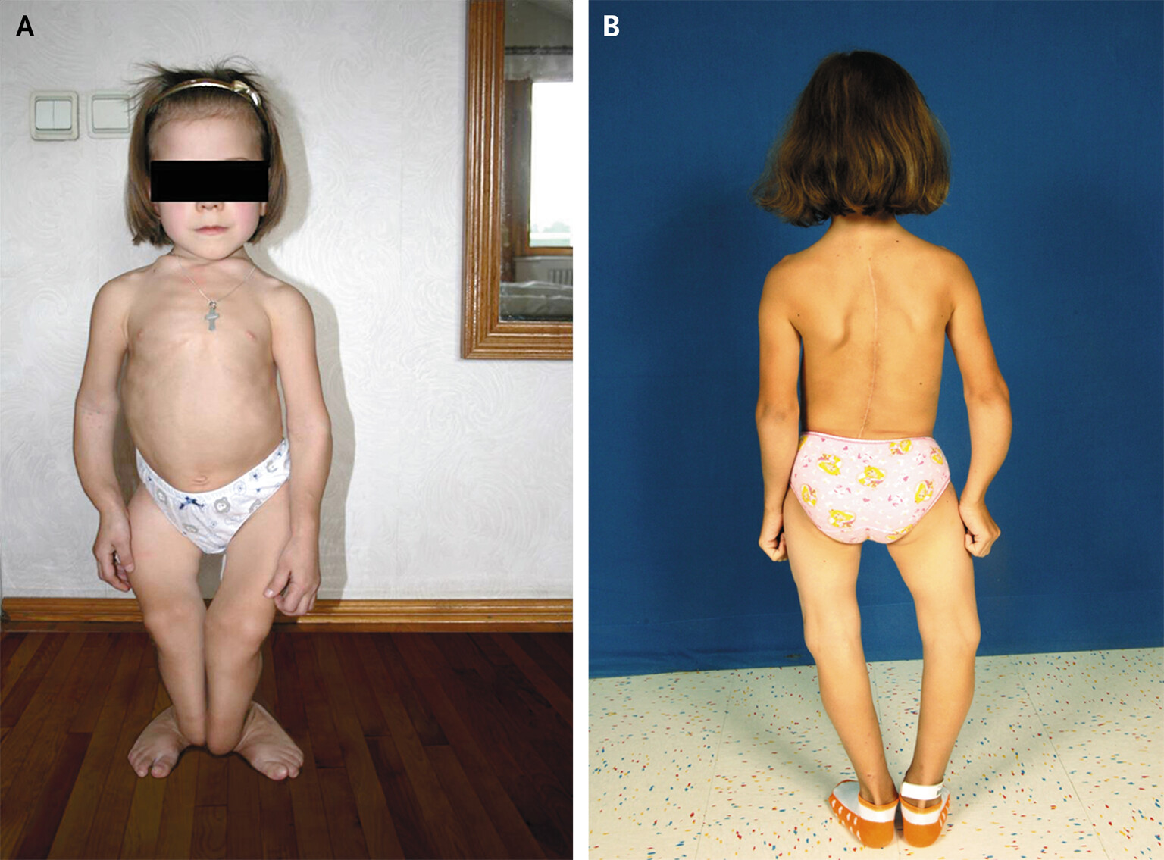
Clinical Features:
Delayed dentition/walking, bone deformities (bow legs, knock knees).
Radiological: Widened epiphyseal lines, cupped metaphyses.
Treatment:
Severe: Shock therapy (600,000 IU cholecalciferol divided into 3 injections 1/week)
Mild/Moderate: Vitamin D (1500-5000 IU)
+ calcium.

Slide 6
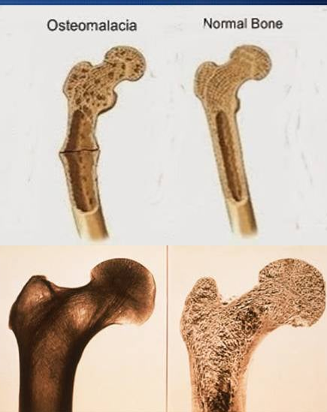
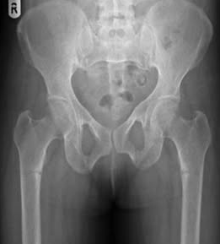
Osteomalacia
Definition: Defective mineralization of osteoid in adults (after physeal closure).
Risk Factors:
  Vitamin D deficiency, malabsorption, renal osteodystrophy, hypophosphatemia.
Clinical Features:
  Bone pain, muscle weakness, waddling gait, pathologic fractures.
  Radiological: Looser’s zones (pseudofractures).
Treatment:
  Vitamin D + calcium supplementation.

Slide 7
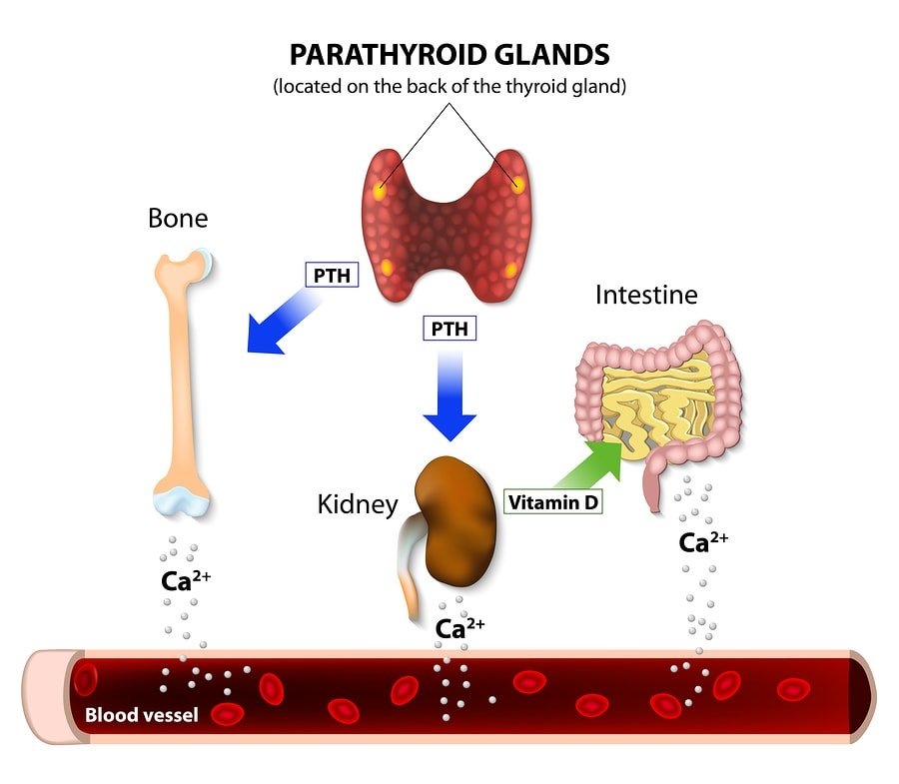
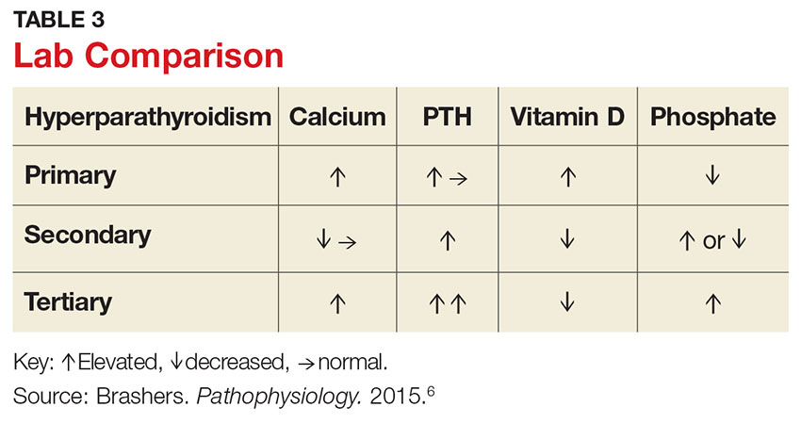
Hyperparathyroidism
Types:
  Primary: Parathyroid adenoma/hyperplasia → ↑ PTH, ↑ calcium.
  Secondary: Chronic kidney disease → ↑ phosphorus, ↓ calcium.
  Tertiary: Autonomous PTH secretion after secondary hyperparathyroidism.
Clinical Features:
  Bone pain, fractures, renal stones, hypercalcemia (fatigue, polyuria).
  Radiological: Subperiosteal erosion, brown tumors.
Treatment:
  Primary: Surgical removal of adenoma.
  Secondary: Treat underlying renal disease.

Slide 8
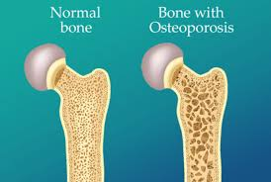
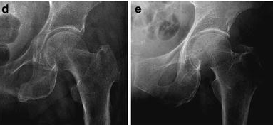
Osteoporosis
Definition: Reduced bone mass and strength (quantitative defect).
Types:
Postmenopausal: Estrogen withdrawal → ↑ bone resorption.
Senile: Age-related bone loss.
Secondary: Corticosteroids, chronic diseases (RA, thyrotoxicosis).
Clinical Features:
Fractures (vertebrae, hip, wrist), kyphosis, back pain.
DEXA Scan: T-score < -2.5 = osteoporosis.

Slide 9
Treatment:
Lifestyle: Calcium (1500 mg/day), vitamin D (400 IU/day), exercise.
Pharmacologic:
  Bisphosphonates: (e.g., alendronate).
  Denosumab(Prolia): SC injection twice yearly.
  Teriparatide(Forteo): SC daily for 2 years.

Slide 10
Feature | Bisphosphonates (e.g., Alendronate, Zoledronate) | Denosumab (Prolia) | Teriparatide (Forteo)
Mechanism of Action | Inhibit osteoclast activity → reduce bone resorption. | Monoclonal antibody → inhibits RANK ligand → prevents osteoclast formation. | Recombinant PTH fragment → stimulates osteoblast activity → increases bone formation.
Administration | Oral (weekly, monthly) or IV (yearly for zoledronate). | Subcutaneous injection every 6 months. | Subcutaneous injection daily for up to 2 years.
Indications | First-line for osteoporosis (postmenopausal, glucocorticoid-induced). | Postmenopausal osteoporosis, men at high risk of fracture. | Severe osteoporosis (high fracture risk), failed bisphosphonate therapy.
Onset of Action | Slow (months to years). | Rapid (within months). | Rapid (within months).
Duration of Use | Long-term (5-10 years). | Long-term (indefinite). | Limited to 2 years.
Adverse Effects | - GI upset (oral). | - Hypocalcemia. | - Hypercalcemia.
 | - Osteonecrosis of the jaw (rare). | - Osteonecrosis of the jaw (rare). | - Leg cramps.
 | - Atypical femoral fractures (long-term use). | - Infections (e.g., cellulitis). | - Dizziness.
Counseling Points | - Take on empty stomach with water. | - Monitor calcium levels. | - Administer at the same time daily.
 | - Remain upright for 30-60 minutes. | - Ensure adequate calcium and vitamin D intake. | - Rotate injection sites.
 | - Avoid calcium supplements within 2 hours.
Contraindications | - Severe renal impairment (eGFR <30-35 mL/min). | - Hypocalcemia. | - Bone metastases.
 | - Hypocalcemia. | - Pregnancy. | - Paget’s disease.
 |  |  | - Prior radiation therapy to bone.
Cost | Low to moderate. | High. | Very high.

Slide 11
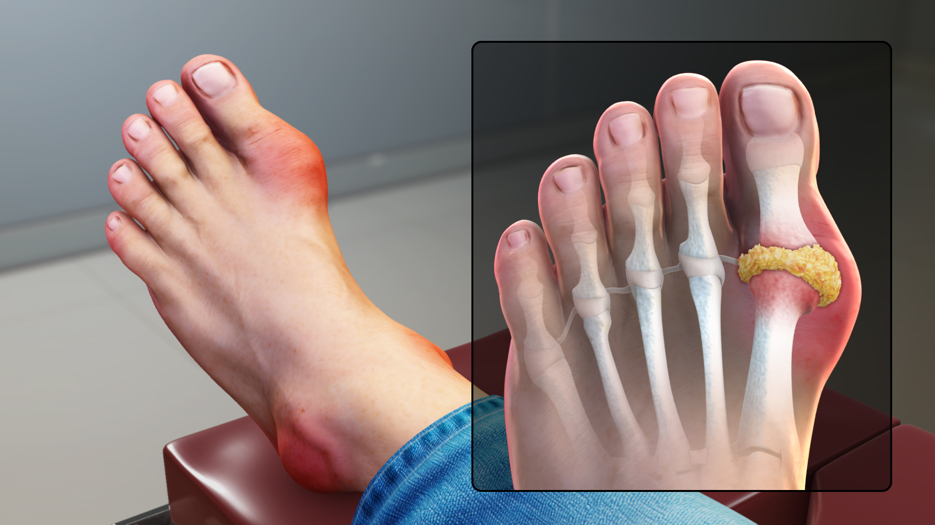
Gout
Definition: Hyperuricemia → urate crystal deposition in joints.
Types:
Primary: Idiopathic purine metabolism disorder.
Secondary: High metabolic turnover (e.g., leukemia, chemotherapy).
Clinical Features:
Acute: Severe joint pain (big toe), swelling, redness.
Chronic: Joint destruction, tophi.

Slide 12
ttt
Acute:
  Bed rest + fluids
  Antiinflammatory drugs:
    Colchicine: oral 1.2 mg then .6 mg single dose
    NSAIDs (except aspirin): indomethacin 50 mg t.d.s
    Steroids: if no response or CI to the previous
Chronic:
  Antihyperuricemic druds:
    Allopurinol: xanthine oxidase inhibitor → ↓ uric acid synthesis (100 mg/day PO initially; increased weekly to 200-300 mg/day up to 600 mg in severe)
    Probenecid: uricosuric drug (250 mg two times a day for about one week, then 500 mg two times a day for a few weeks. After this, the dose will depend on the amount of uric acid in your blood or urine)
      should not be started until an acute gouty attack has subsided
  Antiinflammatory drugs:
    Colchicine: .6 mg 1 to 3 times/day

